Slide 1

Sustainable Claremont
Engineers for a Sustainable World
Conference 2014

Slide 2
Speakers
Barnabas Path | Chair, Sustainable Claremont
Ron Mittino | Schools Lead
Alexis Reyes | Sustainability Coordinator

Slide 3
Agenda
Introduction and Overview
Sustainability Resource Center
Sustainability Initiatives
CASE STUDY | Leveraging the Power of Schools
Questions

Slide 4
Intro
WHY… We Care
WHO… We Are
WHAT… We Do

Slide 5
Why We Care
Sustainability is an environmental initiative;
Sustainability is an economic initiative;
Sustainability is a community initiative;
Sustainability is a moral initiative;
Sustainability is.

Slide 6
Who We Are
Non-Profit created by local activists in 2009
Educate & engage environmentally, economically, and socially
Part-time staffed Sustainability Resource Center at the Rancho Santa Ana Botanical Garden with a $50,000 budget
Support Key Initiatives through Action Groups & Committees

Slide 7
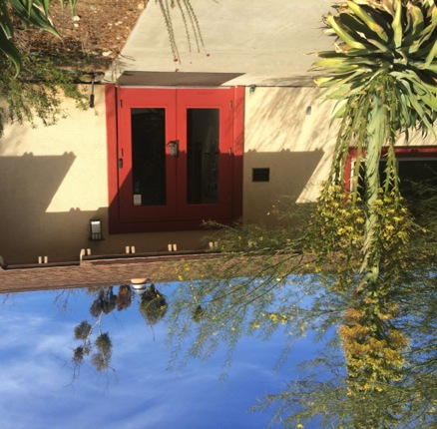
Sustainability Resource Center
Located at the Rancho Santa Ana Botanic Garden
Connects the community and organizations to sustainability resources
Goal: that sustainable education will lead to sustainable action

Slide 8
Sustainability Initiatives
SUSTAINABLE |Energy
SUSTAINABLE |Water
SUSTAINABLE |Environment
SUSTAINABLE |Communities

Slide 9
SUSTAINABLE |Energy
Why do we care?
  80% of Claremont’s energy use is residential
  An average home wastes 50-60% of its energy due to inefficiency
Claremont Home Energy Retrofit Program (CHERP)
  Over 200 homes upgraded
  Best city completion rate in LA County
  Average 28% reduction in energy and GHG
Claremont Energy Educators
  Cool California Challenge
  Sustainability Circles | Community Energy Targets
  Sustainability Curriculum | Students as Teachers

Slide 10
SUSTAINABLE |Water
Why do we care?
  Claremont residents use 320 gallons of water per person per day. (This is more than double the average for SoCal)
  59% of household water use is outdoors
  20% of California’s energy use is water related

Slide 11

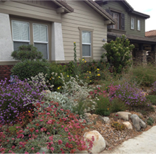
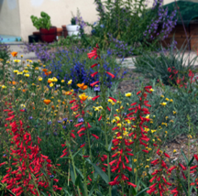
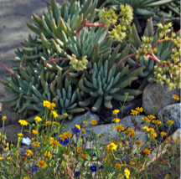
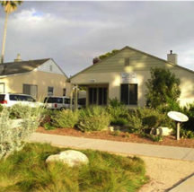
  Connect property owners to a network of local resources
  Promote efficient irrigation, water conservation and water reclamation
  Create attractive climate-appropriate landscape

Slide 12
SUSTAINABLE |Environment
Environmental Action (Air, Water, Earth)
Tree Action Group (TAG)
  GIS Modeling of urban forest assets
  Reasonable & prudent care of forest canopy
Garden Club– natural species and palettes
Waste Management Best Practices
  Recycling & landfill strategies
Transportation
  Bicycling lanes, Ride-Share, Downtown lockers

Slide 13
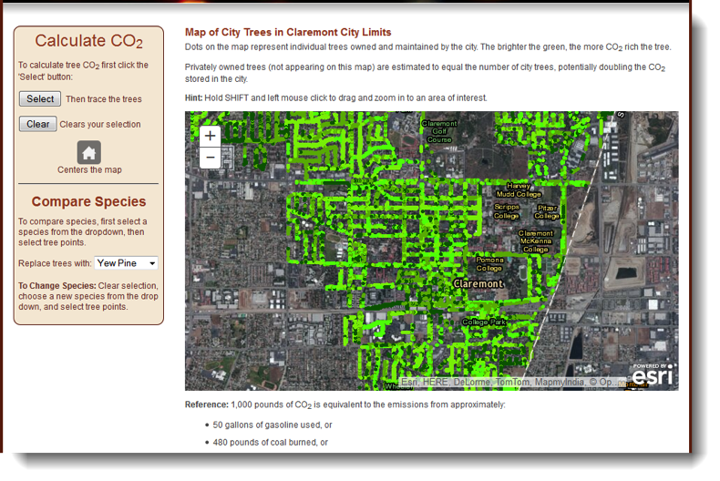
SUSTAINABLE |Environment

Slide 14
SUSTAINABLE |Communities
Claremont Colleges Sustainability Programs
Social Sustainability
  Habitat for Humanity
  Food for Peace, etc.
Economic Sustainability
  Energy Reduction = Increased Spending Power
Schools
  Leveraging knowledge in Energy, Water, Recycling, etc.

Slide 15
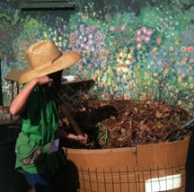
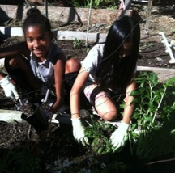
CASE STUDY | Green Schools
Q: Was your schooling like this?

Slide 16
“There may not be sufficient social or political interest to foster conservation of earthworm biodiversity”
-- Sam James
From The Earth Moved by Amy Stewart

Slide 17
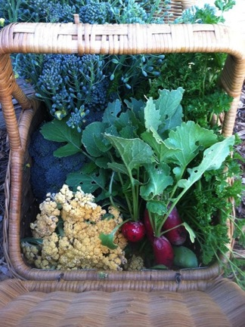
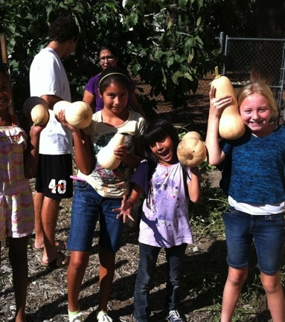
Edible Gardens

Slide 18
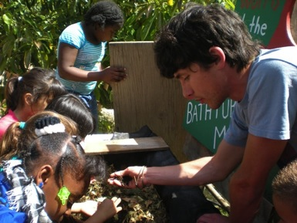
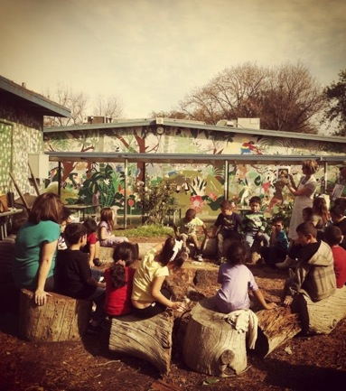
Sustainable Curriculum

Slide 19
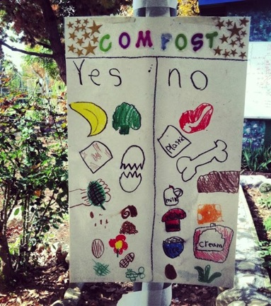
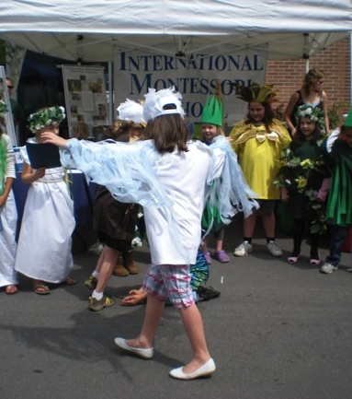
Earth Day

Slide 20
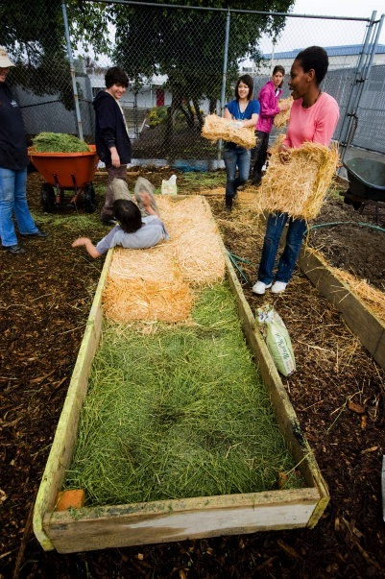
Wow!
No Dig Beds.

Slide 21
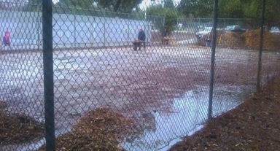
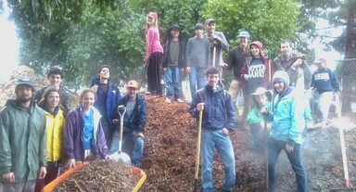
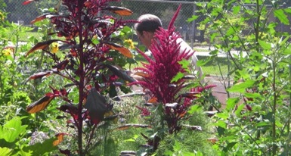
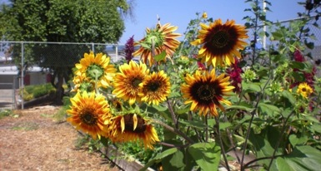
El Roble and PEAR

Slide 22
CUSD
Green Schools Resolution

Slide 23
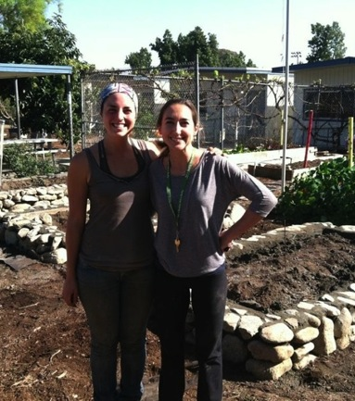
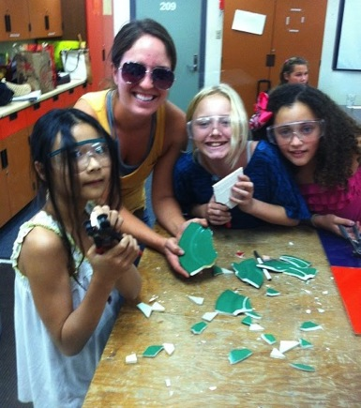
Community Garden Coordinator

Slide 24
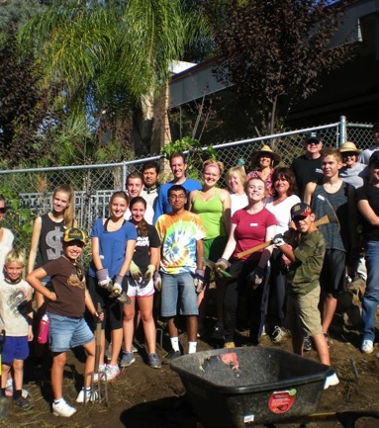
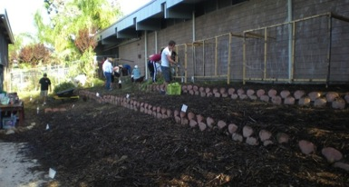
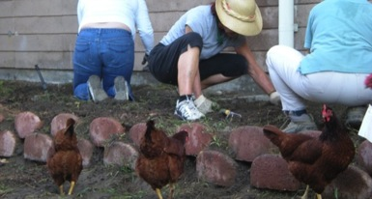
Claremont High School

Slide 25
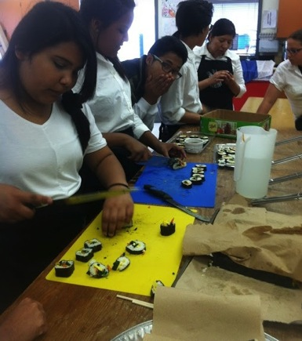
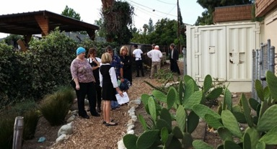
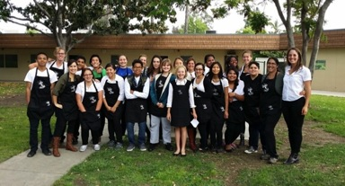
San Antonio Plant Justice

Slide 26
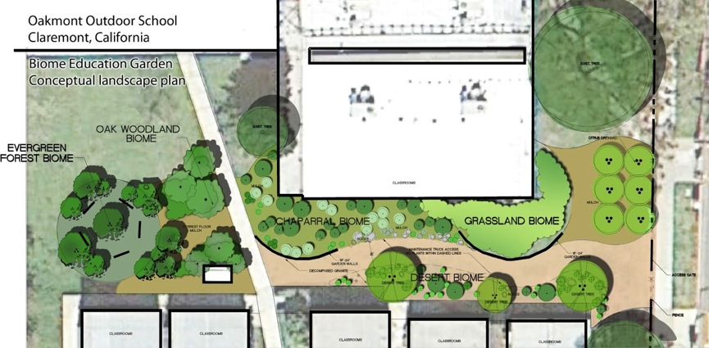
Oakmont Biome Project

Slide 27
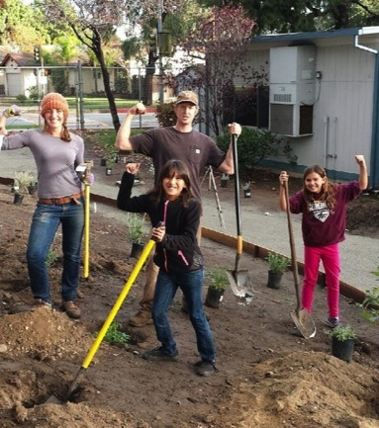
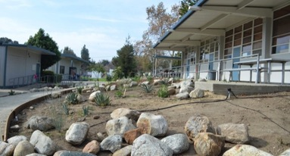
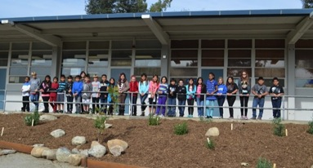
“Many hands make light work.”

Slide 28
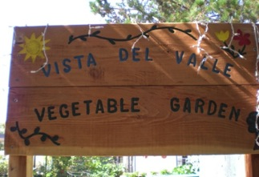
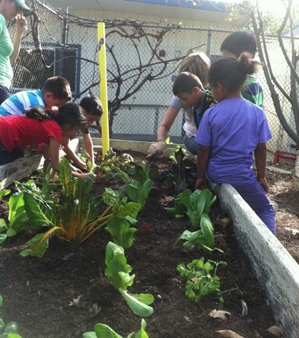
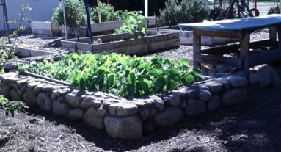
Vista del Valle Elementary

Slide 29
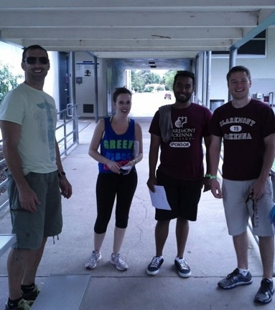
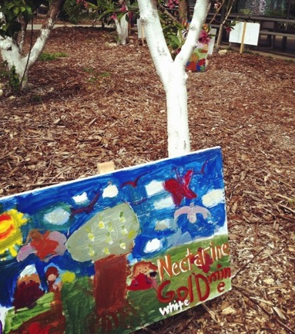
Supporting Groups

Slide 30
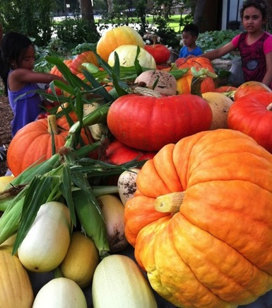
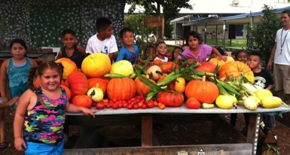
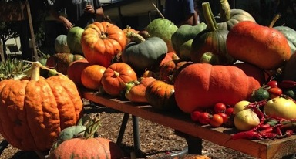
From Seeds to…

Slide 31
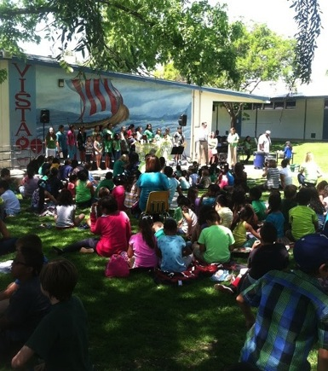
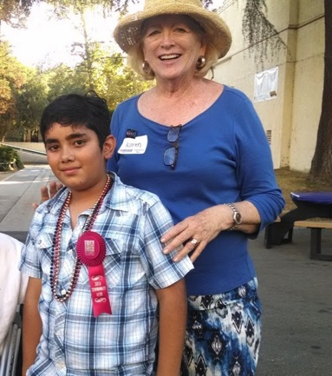
Trash Free Lunch Challenge
& Claremont Hero

Slide 32
Imagine Green Video
https://www.youtube.com/watch?v=GJzr6eBySPE

Slide 33
Q&A

Slide 34
Questions for You
What sustainability issues do you face in your community? After seeing this presentation, what can you do to help?
Real World Constraints.
  Example: the difficulty in implementing a sustainability curriculum in schools
Where’s your niche?
It all starts with education. And it ends with action.

Slide 35
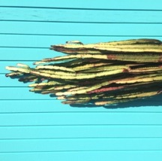

“Go back?” he thought. “No good at all!
Go sideways? Impossible! Go forward?
Only thing to do! On we go!”
So up he got, and trotted along with his
little sword held in front of him
and one hand feeling the wall,
and his heart all of a patter and a pitter.
-- J.R.R. Tolkein, The Hobbit

